Slide 1

Robust Facial Feature Representation Using Positional Micro-Patterns
By
Al Shahriar Rubel – 144434
Adib Ahsan Chowdhury - 144446
Supervised By
Dr. Md. Hasanul Kabir
Associate Professor
Department of Computer Science & Engineering
Islamic University of Technology

Slide 2
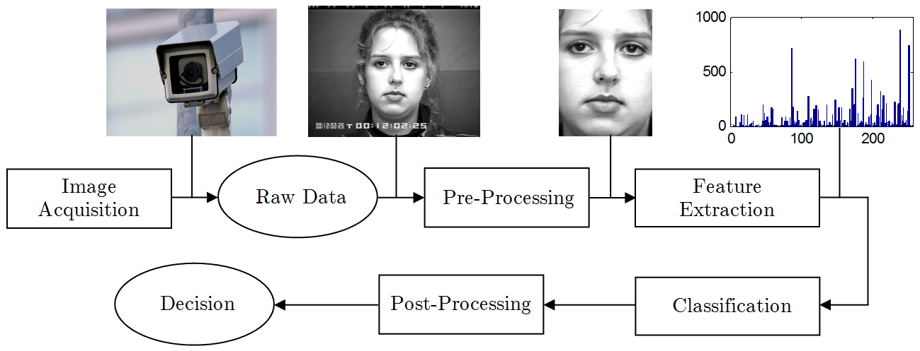
Introduction
Automatic recognition and analysis of human face allow many interesting applications in Biometrics, Human-Computer Interaction, and Security.
Deriving an efficient and effective feature representation is the fundamental component for any successful facial recognition system.
The ongoing research aims to increase the robustness of the underlying feature descriptor against different factors.
Thesis Focus
Figure 1. Overview of a generic facial recognition System

Slide 3
Research Challenges
Although feature extraction receives considerable attention, the inherent variability of facial appearances caused by
variations in illumination, pose, alignment,
occlusion,
facial expression, and
aging
makes recognition in unconstrained environment a difficult and challenging task.
Human faces are non-rigid, dynamic objects with a large diversity in shape, color and texture.
Therefore, finding a facial feature descriptor satisfying the following three criteria is a challenging task:
Distinctiveness
Robustness
Computationally inexpensive cost

Slide 4
Thesis Objectives
Our thesis aimed at designing an effective appearance-based facial feature descriptor based on a robust local texture encoding scheme, which should satisfy the following criteria:
Robust against illumination variations and random noise.
Applicable in different face related problem domains, such as face recognition, facial expression analysis, and gender classification.
Achieve superior performance in unconstrained environment than the existing state-of-the-art techniques.
Computationally efficient and effective.

Slide 5
Literature Review
Categories :
Basic Patterns : Based on Intensity Values
Local Binary Pattern (LBP)
Local Binary Count (LBC)
Local Ternary Pattern (LTP)
Complete Patterns : Based on Sign & Magnitude of intensity difference
Complete Local Binary Pattern (CLBP)
Complete Local Binary Count (CLBC)
Complete Local Ternary Pattern (CLTP)
Volumetric Patterns : Based on the volume
Volume Local Binary Pattern (VLBC)
Complete Volume Local Binary Pattern (CVLBC)
Adaptive Pattern : Based on Adaptive Thresholds
Adaptive Median Binary Pattern (AMBP)
Adaptive Robust Binary Pattern (ARBP)
Directional Age Primitive Pattern (DAPP)

Slide 6
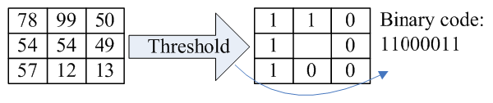
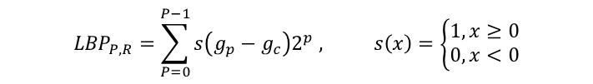
Basic Feature Descriptors
LBP: The LBP (Shan et al., 2009; Ahonen et al., 2006) operator thresholds P neighbor gray values with respect to the center pixel and concatenates the result binomially.
$${LBP}_{P,R}=\sum_{P=0}^{P−1}{s\left(g_{p}−g_{c}\right)2^{p} , s\left(x\right)=\left\{\begin{aligned}1, x≥0 \\ 0, x<0\end{aligned}\right.}$$
Limitation : LBP Performs weakly under the presence of random noise and large illumination variation.
Figure 2. Basic Pattern’s Workflows
Figure 3. Illustration of the basic LBP operator

Slide 7
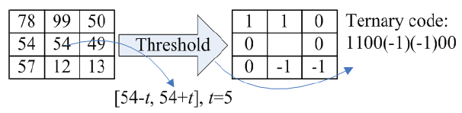
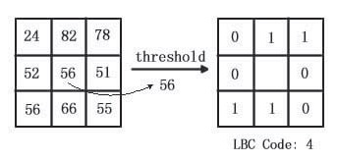
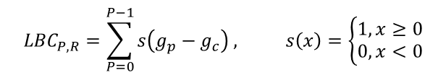
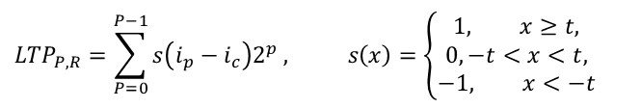
Basic Feature Descriptors(Cont.)
Local Binary Count(LBC)
Local Ternary Pattern(LTP)
It is the same as LBC (Y. Zhao, D.-S. Huang, and W. Jia, 2012), in thresholding the local neighboring pixels, but it differs in the encoding phase by counting the 1s in the thresholded codes rather than applying binary encoding.
Local Ternary Pattern (Tan and Triggs, 2007) introduces one additional discrimination level than LBP, which improves the robustness of LTP feature under the presence of noise.
$${LTP}_{P,R}=\sum_{P=0}^{P−1}{s\left(i_{p}−i_{c}\right)2^{p} , s\left(x\right)=\left\{\begin{aligned}1, x≥t, \\ 0, −t<x<t, \\ −1, x<−t\end{aligned}\right.}$$
$${LBC}_{P,R}=\sum_{P=0}^{P−1}{s\left(g_{p}−g_{c}\right) , s\left(x\right)=\left\{\begin{aligned}1, x≥0 \\ 0, x<0\end{aligned}\right.}$$
Figure 5. Illustration of the basic LTP
Figure 4. Illustration of the basic LBC
Limitations : It may generate same codes for different pixels as it only counts the total number of 1s rather than the position.
Limitations : Still susceptible to noise and illumination variations as it employs simply the gray level values.

Slide 8
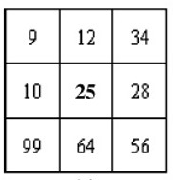
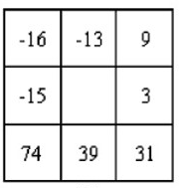
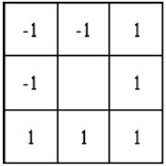
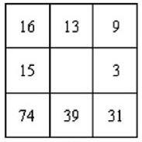
Complete Feature Descriptors
CLBP: In case of CLBP (Z.Guo, L. Zhang, D. Zhang, 2010), a local region is represented by its center pixels & a local difference sign-magnitude transform & decomposes the image local structure into two complementary components Difference signs and Difference magnitude.
CLBP_SIGN
IMAGE
CLBP_MAGNITUDE
Complete
Descriptor
CLBP_CENTER
Figure 6. Complete Pattern’s Workflows
Limitation : CLBP Performs weakly under the presence of random noise and large illumination variation as it uses the same concept of LBP
Figure 7(a).
3x3 Sample Block
Figure 7(b).
The local difference
Figure 7(c).
Sign Components
Figure 7(b).
Magnitude Components

Slide 9
Complete Feature Descriptors(Cont.)
Complete Local Ternary Pattern(CLTP
Complete Local Binary Count(CLBC)
CLBC (Y. Zhao, D.S. Huang, W. Jia, 2012) discards the structural information from LBP operator. They only concentrate on local binary grayscale difference.
It uses the same concept of completeness from CLBP
Condition
For Sign Difference, If Neighbor pixel > Center pixel, it is set to 1, otherwise 0.
For Magnitude Difference, If Magnitude of Local Difference > Average Magnitude of Global Difference, it is set to 1, otherwise 0.
CLTP (T. H. Raseen & B. E. Khoo, 2013) extends the concept of LTP & its framework is similar to CLBP.
Figure 8. CLTP Workflow
Limitations : As it uses the same concept of LTP, it is susceptible to noise and illumination variations.
Limitations : It may generate same codes for different pixels as it only counts the total number of 1s rather than the position like LBC.

Slide 10
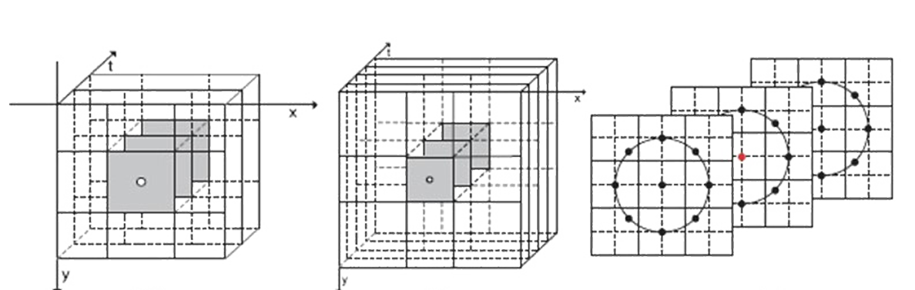
Volumetric Feature Descriptors
In Facial Feature Representation, Volume refers to the collection of 27 pixels - 9 from each of the 3 frames.(shown in the following figure)
Figure 9(a). Volume
with Frame Distance =1
Figure 9(b). Volume
with Frame Distance =2
Figure 9(c).
Circularly Symmetric Neighbour
Among 27 pixels, center pixel of the center frame is considered as center & rest of the 26 pixels are neighbors.

Slide 11
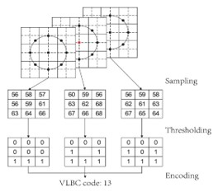
Volumetric Feature Descriptors(cont.)
Volume Local Binary Count(VLBC)
Complete Volume Local Binary Count (CVLBC)
VLBC (X. Zhao, Y. Lin, J. Heikkila, 2018) uses Similar Concept of LBC and extends it to volume.
Instead of 8 pixels, 26 pixels are used as neighbors without exponentially increasing the feature dimensions.
CVLBC(X. Zhao et al. 2018) uses the same concept of completeness from CLBP & the concept of volume from VLBC.
Figure 11. Workflow of CVLBC
Figure 10. Illustration of Computing VLBC
Limitations : Same as VLBC.
Limitations : It may generate same codes for different pixels as it only counts the total number of 1s rather than the position like LBC

Slide 12

Adaptive Feature Descriptors
Adaptive Median Binary Ternary(AMBP)
AMBP (A. Hafiane et al. , 2014) follow similar Concept as LBP, But instead of Center pixel, they use a new Threshold value.
Threshold value is set to local median if local median keeps a particular distance from local minima & local maxima, otherwise set to center pixels.
Local Median
of Image
IMAGE
Local Minima
of Image
Threshold
Local Maxima
of Image
Limitations:
Sensitive to Noise as it has the similar concept of LBP.
Figure 12. Workflow of AMBP

Slide 13
Adaptive Feature Descriptors(Cont.)
Adaptive Robust Binary Pattern(ARBP)
ARBP (X. Wu et al. 2018) follows similar Concept as LBP & AMBP, But it uses local average as an extra parameter which contributes to the Threshold value.
Local Median
of Image
Local Minima
of Image
IMAGE
Threshold
Local Maxima
of Image
98 | 84 | 112
96 | 91 | 74
92 | 89 | 71
Local Average
of Image
Figure 14. 3x3 Local Region of Image
Limitations:
Sensitive to Noise as it directly considers the intensity values.
Figure 13. Workflow of ARBP

Slide 14
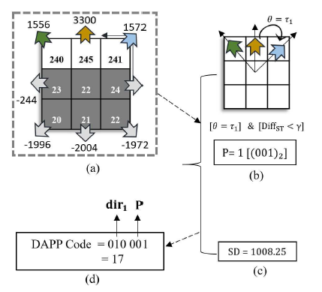
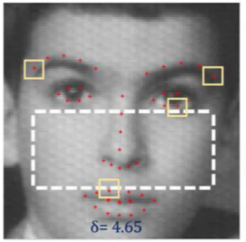
Adaptive Feature Descriptors(Cont.)
Directional Age Primitive Pattern(DAPP)
DAPP(M. T. B. Iqbal et al., 2017) efficiently represents both cranio-facial growth(shape) & skin aging (texture) information.
Initially 3 states are considered- (1) is set for Wrinkle textures, (2) is set for lip/eye corners, otherwise it is set to 0.
Wrinkles can appear either as straight edges or curved edges & secondary & tertiary edge response can be clockwise or counter clockwise to each-other. All these information extend these three categories into six.
Threshold is generated from the Standard Deviation (SD) of edge responses of cheek region
Condition 1
State 1
Condition 2
State 2
Condition 3
State 3
IMAGE
DAPP
Condition 4
State 4
Condition 5
State 5
Condition 6
State 6
Cheek Region
Figure 15. Workflow of ARBP

Slide 15
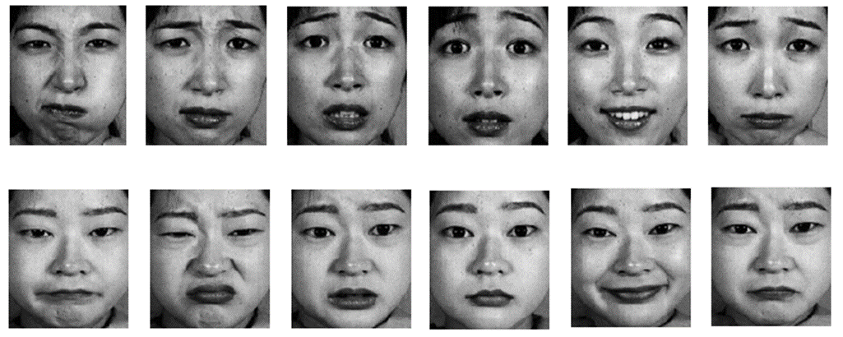
Experiments & Results
We have setup our experiment for Facial expression Recognition and Texture Classification using K Nearest Neighbor(KNN).
We have used JAFFE Dataset with 6 class expression which includes anger, fear, disgust, joy, sadness and surprise and UCLA Dataset for Texture Classification
We selected 213 images of 10 Japanese female subjects from JAFFE dataset and the selected images were cropped and normalized to 140x140 pixels
Figure 16 : Sample expression images from the JAFFE database

Slide 16
Experiments & Results(Cont.)
We fixed the number of regions to (10x10) for each image
We compute feature vector for each region and then concatenate them
We experimented with 4 types of descriptors and
one of them was used for “Texture Recognition”
Basic Pattern
LBP
LBC
LTP
Complete Pattern
CLBP
CLBC
CLTP
Volumetric Pattern for “Texture Recognition”
VLBC
CVLBC
Adaptive Pattern
AMBP
ARBP
DAPP
Figure 1.10X10 regions

Slide 17
Experiments & Results(Cont.)
Facial Expression Recognition Rate on JAFFE Database
Facial Expression Recognition Rate on JAFFE Database
Descriptor | Accuracy (%)
LBP | 88.56
LBC | 86.64
LTP | 89.74
Descriptor | Accuracy (%)
CLBP | 88.93
CLBC | 88.71
CLTP | 91.23
Dynamic Texture Recognition Rate on UCLA Database
Facial Expression Recognition Rate on JAFFE Database
Descriptor | Accuracy (%)
VLBC | 96.00
CVLBC | 97.50
Descriptor | Accuracy (%)
AMBP | 87.69
ARBP | 87.85
DAPP | 91.27

Slide 18
Conclusion
Our Proposal
Based on the performance of the feature descriptors, we are motivated to propose a new facial feature descriptor using the concept of CLTP with the following modification and additional feature
Instead of 3, We will experiment with 4 feature codes and concatenate them to generate final feature vector.
Sign_Code
Magnitude_Code
Directional_Code
Center_Code
Instead of directly using pixel values, we will consider Edge Responses to generate Sign_Code & Magnitude_Code
We will consider one additional feature of directional information
Instead of user defined threshold, we will experiment with adaptive threshold from flat region

Slide 19


Slide 20
References
T. Ojala, M. Pietikainen and D. Harwood, “A comparative study of texture measures with classification based on feature distributions” Pattern Recognition vol. 29, 1996.
Zhao, Yang, De-Shuang Huang, and Wei Jia. "Completed local binary count for rotation invariant texture classification." IEEE transactions on image processing 21.10 (2012): 4492-4497.
X. Tan and B. Triggs, “Enhanced local texture feature sets for face recognition under difficult lighting conditions,” IEEE Transactions on Image Processing, vol. 19, no. 6, pp. 1635–1650, 2010.
Guo, Zhenhua, Lei Zhang, and David Zhang. "A completed modeling of local binary pattern operator for texture classification." IEEE Transactions on Image Processing 19.6 (2010): 1657-1663.
Y.Zhao, D. S. Huang, andW. Jia, “Completed local binary count for rotation invariant texture classification,” IEEE Transactions on Image Processing, vol. 21, no. 10, pp. 4492–4497, 2012
Rassem, Taha H., and Bee Ee Khoo. "Completed local ternary pattern for rotation invariant texture classification." The Scientific World Journal 2014 (2014).
Zhao, Xiaochao, Yaping Lin, and Janne Heikkilä. "Dynamic texture recognition using volume local binary count patterns with an application to 2D face spoofing detection." IEEE Transactions on Multimedia 20.3 (2018): 552-566.
A. Haane, K. Palaniappan, and G. Seetharaman, ``Adaptive median binary patterns for texture classication,'' presented at the Int. Conf. Pattern Recognit., Aug. 2014
Wu, Xuelian, et al. "Hyphae Detection in Fungal Keratitis Images With Adaptive Robust Binary Pattern." IEEE Access 6 (2018): 13449-13460.
Iqbal, Md Tauhid Bin, et al. "Directional age-primitive pattern (DAPP) for human age group recognition and age estimation." IEEE Transactions on Information Forensics and Security12.11 (2017): 2505-2517.

